Slide 1
Inheritance

Slide 2
Mapping Inheritance
1 Table per concrete class
Discard polymorphism and inheritance relationships completely from the relational model
2 Table per class hierarchy
An entire class hierarchy could be mapped to a single table. This table would include columns for all properties of all classes in the hierarchy.
3 Table per subclass
Represent "is a" (inheritance) relationships as "has a“ (foreign key) relationships

Slide 3


Slide 4
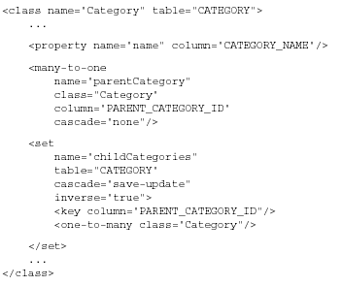

Slide 5
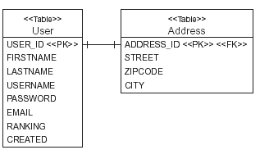
Primary key one – to – one mapping

Slide 6
<one-to-one name="address“ class="Address"
  cascade="save-update"/>
  <one-to-one name="user“ class="User"
  constrained="true"/>

Slide 7
<class name="Address" table="ADDRESS">
<id name="id" column="ADDRESS_ID">
<generator class="foreign">
<param name="property">user</param>
</generator>
</id>
<one-to-one name="user“ class="User"
  constrained="true"/>
</class>

Slide 8
HQL
The Hibernate Query Language is an object-oriented dialect of the familiar relational query language SQL.
HQL bears close resemblances to ODMG OQL and EJB-QL; but unlike OQL, it’s adapted for use with SQL databases, and it’s much more powerful and elegant than EJB-QL
EJB-QL 3.0 will be very similar to HQL
HQL isn’t a data-manipulation language like SQL.
It’s used only for object retrieval, not for updating, inserting, or deleting data.
Object state synchronization is the job of the persistence manager, not the developer.

Slide 9
Query By criteria(QBC)
The Hibernate query by criteria (QBC) API lets you build a query by manipulating criteria objects at runtime.
This approach lets you specify constraints dynamically without direct string manipulations
it doesn’t lose much of the flexibility or power of HQL.

Slide 10
Three ways to express queries
session.createQuery("from Category c where c.name like ‘computer%'");
session.createCriteria(Category.class)
.add( Expression.like("name", “computer%") );
session.createSQLQuery("select {c.*} from CATEGORY {c} where NAME like 'Laptop%'",
"c",Category.class);

Slide 11
pagination
List results = session.createQuery("from User u order by u.name asc")
.setFirstResult(0)
.setMaxResults(10)
.list();
List results = session.createCriteria(User.class)
.addOrder( Order.asc("name") )
.setFirstResult(40)
.setMaxResults(20)
.list();

Slide 12
Listing and Iterating the Result
List result = session.createQuery("from User").list();
Iterator iter = result.iterator();

Slide 13
Binding parameters
String queryString = "from Item i where i.description like '" + searchString + "'";
List result = session.createQuery(queryString).list();
Using named parameter
String queryString =
"from Item item where item.description like :searchString";
List result = session.createQuery(queryString)
.setString("searchString", searchString)
.list();

Slide 14
Mutiple parameters
String queryString = "from Item item “ + "where item.description like :searchString “ + "and item.date > :minDate";
List result = session.createQuery(queryString)
.setString("searchString", searchString)
.setDate("minDate", minDate)
.list();

Slide 15
Positional parameters
String queryString = "from Item item “ + "where item.description like ? "
+ "and item.date > ?";
List result = session.createQuery(queryString)
.setString(0, searchString)
.setDate(1, minDate)
.list();

Slide 16
Binding Objects
String queryString = "from Item item “ + "where item.seller=:seller and “ + "item.description like :desc";
session.createQuery(queryString)
.setParameter( "seller", seller, Hibernate.entity(User.class) )
.setParameter( "desc", description, Hibernate.STRING )
.list();
Query q =session.createQuery("from Bid bid where bid.amount > :amount");
q.setParameter( "amount",givenAmount,
Hibernate.custom(MonetaryAmountUserType.class) );
List result = q.list();

Slide 17
String queryString = "from Item item "+ "where item.seller = :seller and "
+ "item.description like :desc";
session.createQuery(queryString)
.setParameter("seller", seller)
.setParameter("desc", description)
.list();

Slide 18
Named Queries
We don’t like to see HQL string literals scattered all over the Java code unless they’re necessary.
Hibernate lets you externalize query strings to the mapping metadata, a technique that is called named queries.
This allows you to store all queries related to a particular persistent class (or a set of classes) encapsulated with the other metadata of that class in an XML mapping file.
Named queries don’t have to be HQL strings; they might even be native SQL queries
session.getNamedQuery("findItemsByDescription")
.setString("description", description)
.list();
<query name="findItemsByDescription"><![CDATA[
from Item item where item.description like :description
]]></query>

Slide 19
Where clause
from User u where u.email = 'foo@hibernate.org'
Criterion emailEq = Expression.eq("email", "foo@hibernate.org");
Criteria crit = session.createCriteria(User.class);
crit.add(emailEq);
User user = (User) crit.uniqueResult();

Slide 20
User user = (User) session.createCriteria(User.class)
.add( Expression.eq("email", "foo@hibernate.org") )
.uniqueResult();
select U.USER_ID, U.FIRSTNAME, U.LASTNAME, U.USERNAME, U.EMAIL from USER U where U.EMAIL = 'foo@hibernate.org'

Slide 21
Comparison operators
HQL supports the same basic operators as SQL: =, <>, <, >, >=, <=, between, not
between, in, and not in.
from Bid bid where bid.amount between 1 and 10
from Bid bid where bid.amount > 100
from User u where u.email in ( "foo@hibernate.org", "bar@hibernate.org" )

Slide 22
criteria
session.createCriteria(Bid.class)
.add( Expression.between("amount",
new BigDecimal(1),
new BigDecimal(10))
).list();
session.createCriteria(Bid.class)
.add( Expression.gt("amount", new BigDecimal(100) ) )
.list();
String[] emails = { "foo@hibernate.org", "bar@hibernate.org" };
session.createCriteria(User.class)
.add( Expression.in("email", emails) )
.list();

Slide 23
null
from User u where u.email is null
session.createCriteria(User.class)
.add( Expression.isNull("email") )
.list();
from User u where u.email is not null
session.createCriteria(User.class)
.add( Expression.isNotNull("email") )
.list();

Slide 24
Arithmetic Expressions
Supported only be HQL
from Bid bid where ( bid.amount / 0.71 ) - 100.0 > 0.0

Slide 25
String matching
from User u where u.firstname like "G%"
from User u where u.firstname not like "%Foo B%"
session.createCriteria(User.class)
.add( Expression.like("firstname", "G%") )
.list();
session.createCriteria(User.class)
.add( Expression.like("firstname", "G", MatchMode.START) )
.list();
The allowed MatchModes are START, END, ANYWHERE, and EXACT.

Slide 26
Sql functions
An extremely powerful feature of HQL is the ability to call arbitrary SQL functions in the where clause.
from User u where lower(u.email) = 'foo@hibernate.org‘
The Criteria API doesn’t currently support SQL function calls.
session.createCriteria(User.class)
.add( Expression.eq("email", "foo@hibernate.org").ignoreCase() )
.list();
from User user
where ( user.firstname || ' ' || user.lastname ) like 'G% K%‘

Slide 27
Logical Operators
from User user where user.firstname like "G%" and user.lastname like "K%“
from User user where ( user.firstname like "G%" and user.lastname like "K%" ) or user.email in ( "foo@hibernate.org", 123@yahoo.com”)
session.createCriteria(User.class)
.add( Expression.like("firstname", "G%") )
.add( Expression.like("lastname", "K%") )
Criteria crit = session.createCriteria(User.class)
.add(Expression.or(Expression.and(
Expression.like("firstname", "G%"),
Expression.like("lastname", "K%")
),
Expression.in("email", emails)
)
);

Slide 28
Ordering query results
from User u order by u.username
from User u order by u.username desc
from User u order by u.lastname asc, u.firstname asc
List results = session.createCriteria(User.class)
.addOrder( Order.asc("lastname") )
.addOrder( Order.asc("firstname") )
.list();

Slide 29
select distinct item.description from Item item
select item.startDate, item.endDate, upper(item.name) from Item item

Slide 30
aggregation
select count(*) from Item
Integer count = (Integer) session.createQuery("select count(*) from Item").uniqueResult();
select count(item.successfulBid) from Item item
select sum(item.successfulBid.amount) from Item item
select min(bid.amount), max(bid.amount)
from Bid bid where bid.item.id = 1
select count(distinct item.description) from Item item

Slide 31
Grouping
select u.lastname, count(u) from User u
group by u.lastname
select bid.item.id, avg(bid.amount) from Bid bid group by bid.item.id
select user.lastname, count(user)
from User user group by user.lastname
having user.lastname like 'A%'

Slide 32
Collection Filter
List results = session.createFilter( item.getBids(), "order by this.amount asc" )
.list();

Slide 33
Sub query
from Bid bid where bid.amount + 1 >= (
select max(b.amount) from Bid b)
from User u where 10 < (select count(i) from u.items i where i.successfulBid is not null)

Slide 34
the following query returns items where all bids are less than 100
from Item item where 100 > all ( select b.amount from item.bids b )
This query returns all items with bids greater than 100
from Item item where 100 < any ( select b.amount from item.bids b )
This query returns items with a bid of exactly 100
from Item item where 100 = some ( select b.amount from item.bids b )

Slide 35
Native SQL queries
String sql = "select u.USER_ID as {user.id},"+ " u.FIRSTNAME as {user.firstname},"+ " u.LASTNAME as {user.lastname} from USERS u";
List results = session.createSQLQuery(sql, "uzer", User.class).list();
List results =
session.createSQLQuery("select {user.*} from USERS user","user", User.class).list();

Slide 36
Stored Procedure
In Hibernate 2.x, there is no direct support for stored procedures.
You have to get the JDBC connection and execute the SQL yourself.
Support will be provided in the next release

Slide 37
Batch fetching
<set name="bids" lazy="true" inverse="true" batch-size="10">

Slide 38
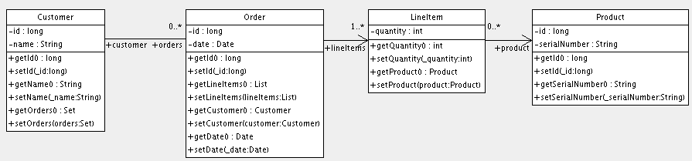
Try this

